Slide 1
Week 5: Programming RC Car
Week 5: Link to slides here https://tinyurl.com/5n8hs7ue

Slide 2
Programming RC Car: Slave Device
As mentioned last week we’re going to be programming the RC Car. First we’re going to be uploading the Slave Device Program and explaininig how it works
Here is the program : WEEK 5 RC Car Program
If you need to reference the sketch to setup the Bluetooth motor driver please refer to the following link: https://drive.google.com/file/d/1yxhJ599-1NN7MU3veZjL_XdSvfkh3FPP/view?usp=sharing

Slide 3
Slave Device program
Here we are defining the pins to be used in the sketch and initializing variables
Lines 9-21
Next we are we are setting the pinMode and the communicate rate which is 9600 by default for our Bluetooth module
Lines 23-31
From here we begin the loop and set our x and y values and read in the x and y position from the master device and convert the values given into x and y coordinates to be used in figuring out which direction should the Car move
Lines 31 - 48

Slide 4
Slave Device program: X axis control
The first if statement is used to determine backwards control by determining if the X axis is less than 470 (meaning the Joystick is moving downwards) then set the motors in reverse and decrease the speed according to the amount the x axis is decreasing (This is done by mapping the values 470-0 into 0- 255)
Lines 50-61
We’re doing the samething for the else if statement only this time saying is the value is greater than 550(Joystick is moving upwards) then move forward and adjust speed accordingly
Lines 62-72
Else the Joystick is in the center meaning no movement so set the motor speeds to 0
Lines 73-77

Slide 5
Slave Device program: Y axis control
Again we’re checking what direction the Joystick is and in this case if it is moving right(less than 470) then all we do is map our Y coordinates onto Motor speeds and decrease the left motor and increase the right motor according to our Y value. To make sure our motor values don’t go out of bounds we confine the range from 0 to 225 by using two if statements
Lines 80 - 92
Doing the same thing as our previous if statement only this time checking the left side
Lines 94-107
Lastly to prevent motors buzzing at low speeds we adjust the motor speed to stop at a certain point(This is different for most motors, in our case I would say go for 70 or 60). Once we’ve gone through all the statements all we do is write our motor speed to the motor driver
Lines 109 - 117

Slide 6
Programming RC Car: Master Device
Next we’re going to upload the Master Device program to our Joystick.
Here is the link to the program: https://docs.google.com/document/d/1GaaSProHbPVCk9kvQ2O6Txj_8h_8hvFqQ-qUjixzKDE/edit?usp=sharing
If you need to refer to the Joystick sketch: https://drive.google.com/file/d/1ArzZirRjAhK26tah6lEkEn3Ihp_Tv2Hr/view?usp=sharing

Slide 7
Master Device program
Here all we’re doing is creating our x and y variables and setting up the communicate rate
Lines 9 - 13
Next we’re reading in our analog values (The coordinates from the Joystick) and then sending the values via the serial port to the slave device. We divide by 4 to convert the X and Y coordinates to Motor speed values and because values 0 - 255 can be sent over as 1 byte which is easier to be accepted by the Slave dveice
Lines 15-23

Slide 8

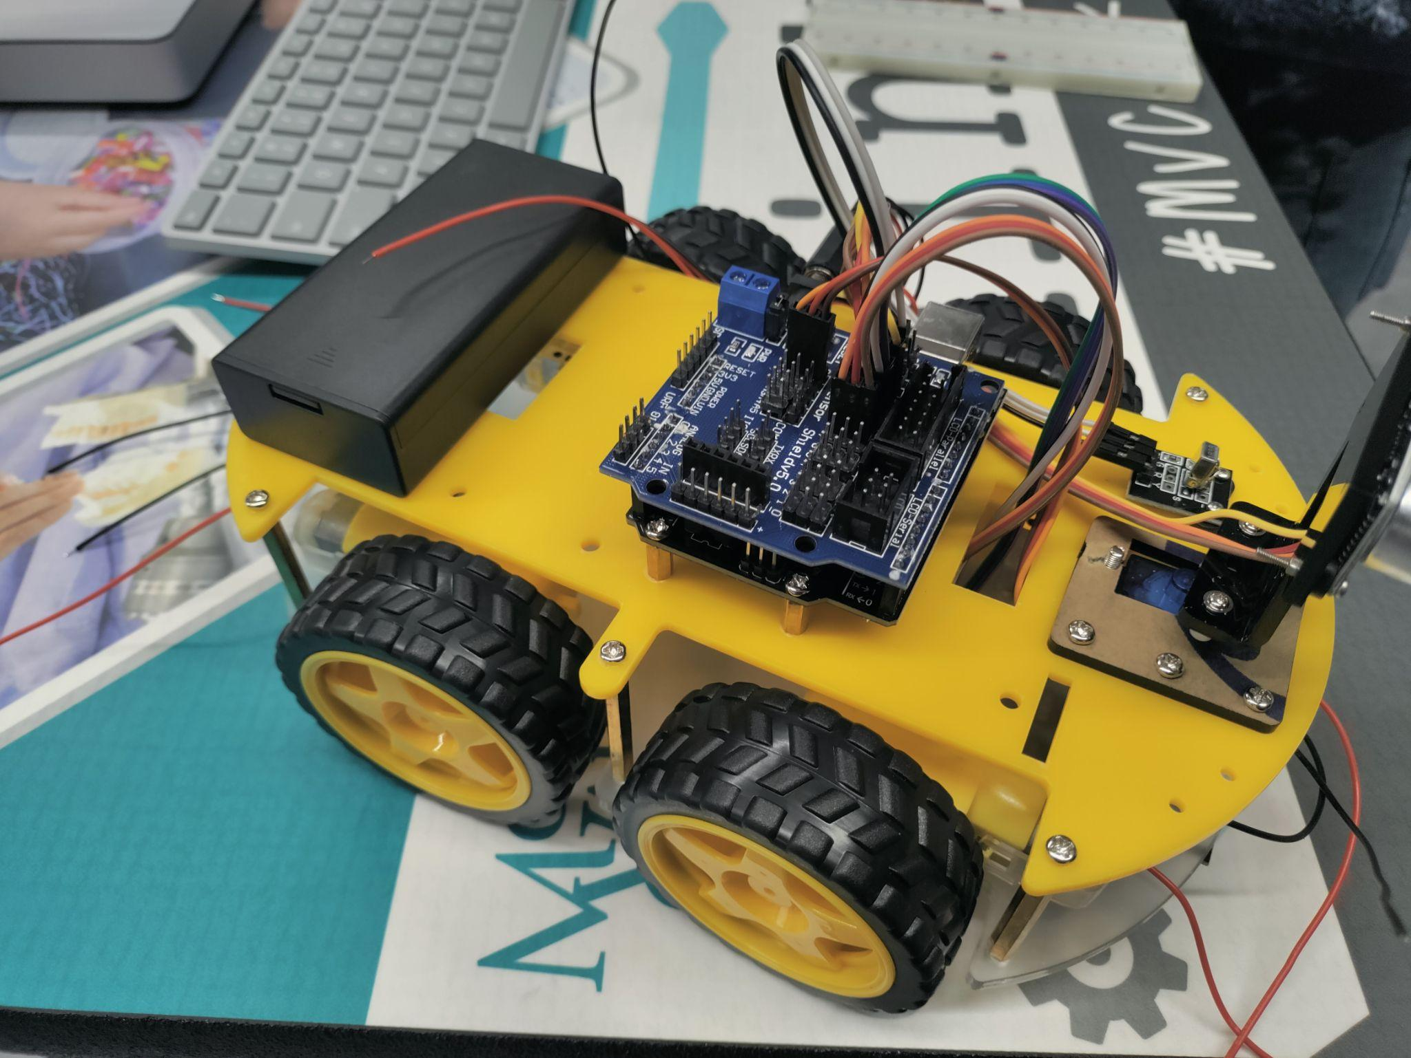
Finished
Once everything has been uploaded correctly and you are able to move the motors using the joystick then you have successfully built an RC Car using arduino. Congrats!

Slide 9
SOURCES for these slides
Arduino Robot Car Wireless Control using HC-05 Bluetooth, NRF24L01 and HC-12 Transceiver Modules - How To Mechatronics

